Slide 1

Welcome
We’re glad you are here.

Slide 2
Who are we?
Our club helps people from diverse backgrounds become more confident speakers, communicators and leaders.

Slide 3
City of Bryan Club
Club Number: 5941, 56, Area L40
Charter Date: Jun. 1, 1994
We meet on Thursdays from 12:00—1:00 PM
CLARA B. MOUNCE PUBLIC LIBRARY
Bryan, Texas

Slide 4
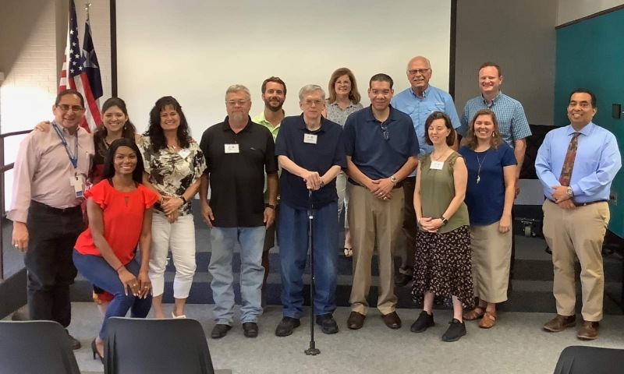
WE ARE ORDINARY, JUST LIKE YOU.

Slide 5
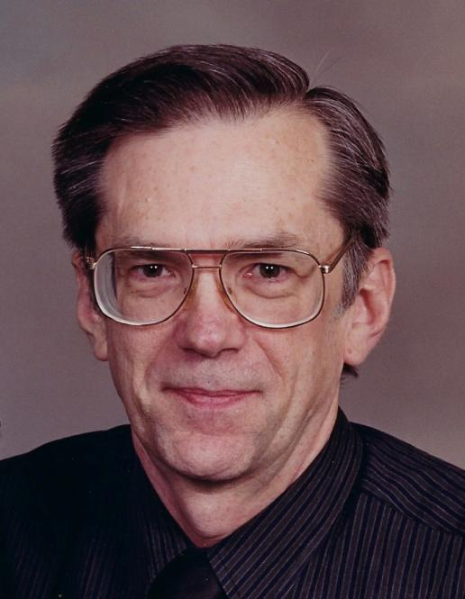
Members
Meet our members:
Aaron Wilton has been a member of the City of Bryan Toastmasters Club since 2018. He is a retired pharmacist, serving in Texas for about 30 years before retiring in 2007. He is married and has called the Bryan/CS area his home for over 40 years. Since joining the City of Bryan Club, Aaron has embraced the Toastmasters Pathways program, completing multiple Pathways, and he is now working on a fourth Pathway. He has served two years as the Club Vice President of Education, and for the Toastmaster 2020-2021 year, he served as both the Club President and the Area L44 Director. For the 2022-2023 year he serves as the Club Secretary and Treasurer.
Aaron’s advice to those looking into what Toastmasters can provide is to consider an environment where individuals can enhance and develop both their speaking and leadership skills in a positive and encouraging atmosphere.

Slide 6
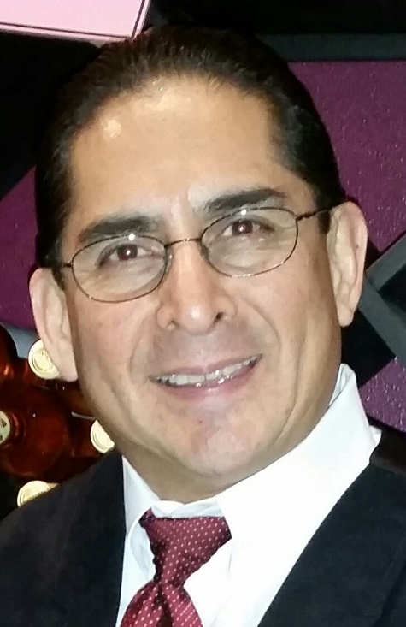
Members
Meet our members:
Fidel Fernandez has been a member of the City of Bryan Toastmasters Club since 2015. He is a retired university administrator, serving at Texas A&M for 28 years before retiring in 2015. He is married to Jan and has two grown children and 7 grandchildren and has called the Bryan/CS area his home for over 35 years. Fidel is the owner and founder of Career Wolves, an organization that provides personal and career coaching, talent acquisition, and talent placement. He is a member on the Board of Directors of Brazos Writers, and a Board Member of the Health Sciences Academy at Round Rock High School. He also works at counseling Blinn students and has worked as a bus driver for the public school. He has achieved the Advanced Communicator Gold in the former Toastmaster Educational plan. Since joining the City of Bryan Club, Fidel has served as Club President twice and has served as the Vice President of Membership.

Slide 7
City of Bryan Toastmasters
Thursdays from 12:00—1:00 PM
CLARA B. MOUNCE PUBLIC LIBRARY
(Click the arrow when in Slide Show mode)
Notes:
In Slide Show mode, click the arrow to enter the PowerPoint Getting Started Center.

